Slide 1
Cavendish Astrophysics Theme
Strategy in the Context of Cambridge Astronomy

Slide 2
Experimental astrophysics within Cambridge
Define the physics problem and invent
new ways of tackling is
Design build and get working the
experiment, telescope and/or software
we need to do it
Wider range of tools than most groups
Areas of expertise
  Data analysis and gravitational theory
  Big Data technology and software
  High-precision optical instruments
  Radio astronomy
Extrasolar planetary science
Radio cosmology, neutral hydrogen and the transient Universe
Gravitational physics
Galaxy evolution
Staff profile ~ 85 people:
  54 research and technical staff
  2 admin
  15-25 students
  5 very active emeritus staff
Lords Bridge our own Radio Observatory just south of Cambridge
  AMI Large Array (8-element interferometer)
  AMI Small Array (10-element interferometer)
  SKA & HERA Test ranges
  eMERLIN dish
Faculty contributing to the strategy
  Paul Alexander (9)
  Anthony Lasenby (3)
  Roberto Maiolino
  Didier Queloz
  Dave Buscher
  Chris Haniff
  Mike Hobson
  Richard Saunders (2)
  Dave Green (8)

Slide 3
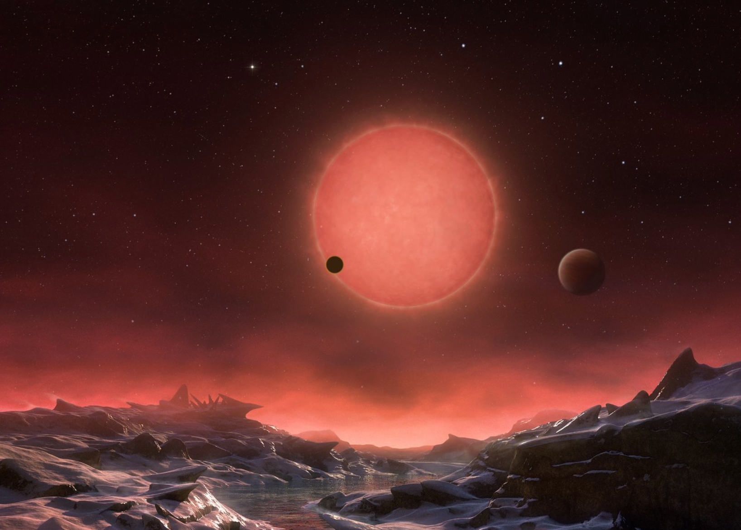
Exoplanet Science
How do planets form and evolve ?
towards an universal model for planetary systems
How diverse are planetary systems ?
Our Solar system in perspectives
Is there life elsewhere ?
Understanding the origin, prevalence and nature of life
in the Universe.

Slide 4
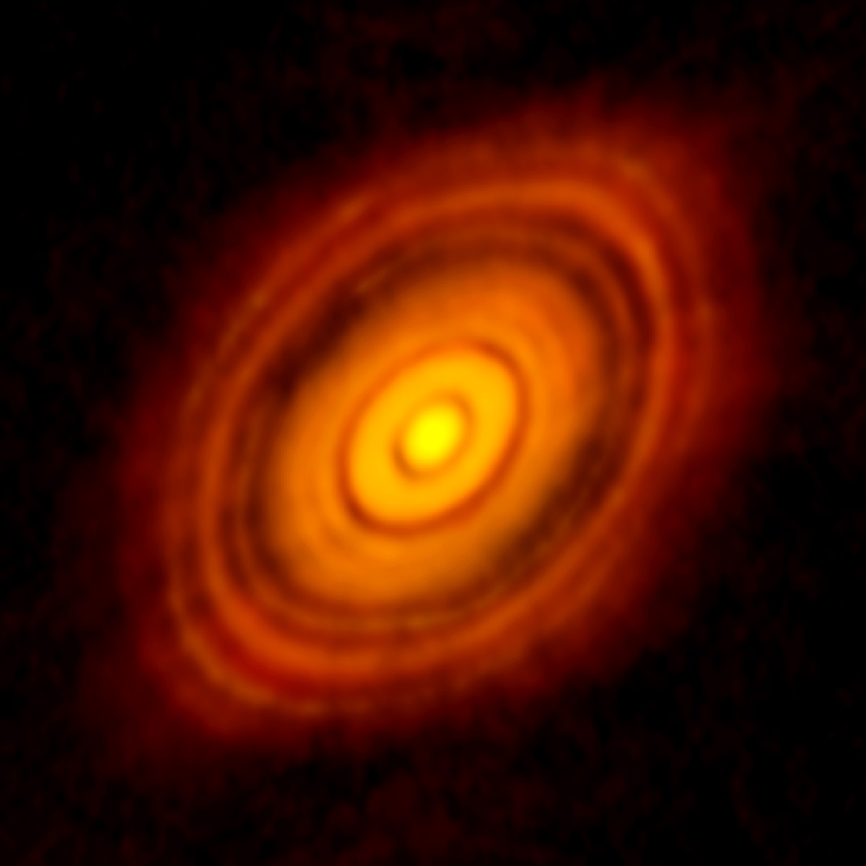
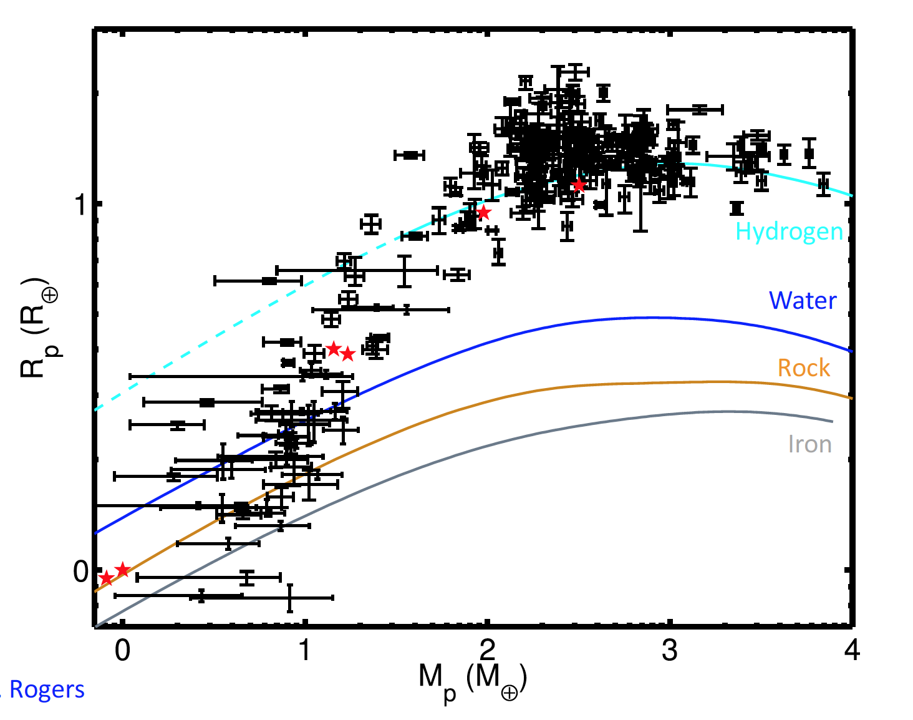

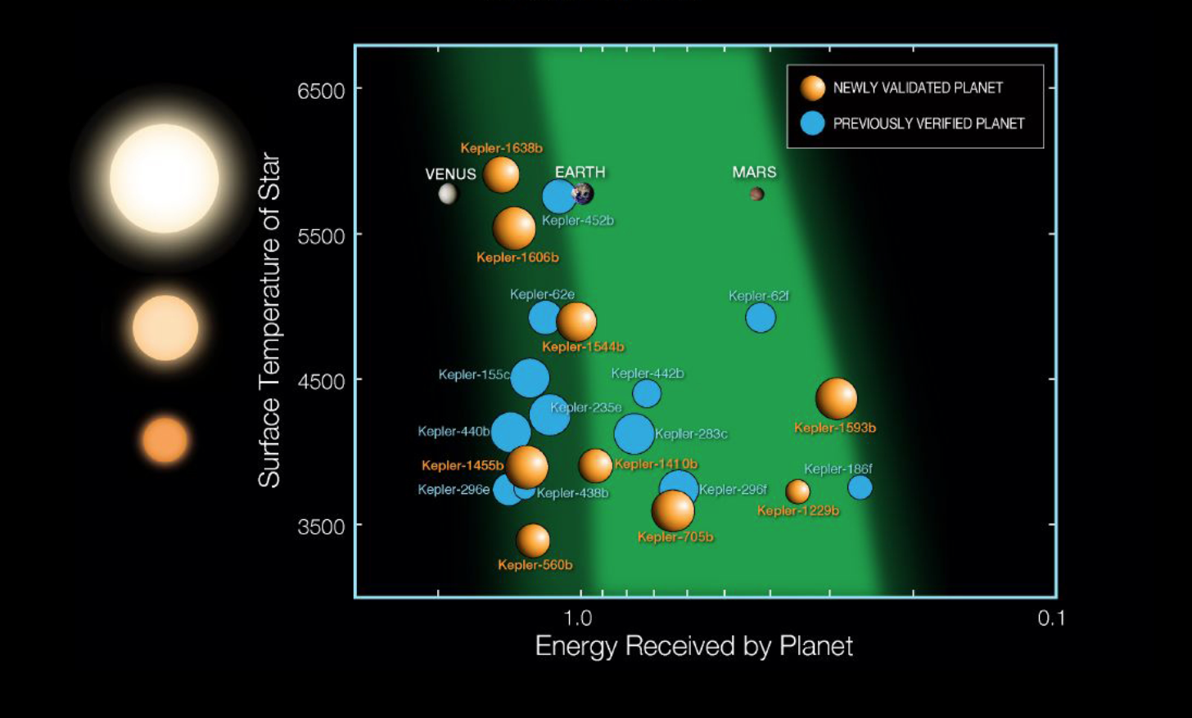
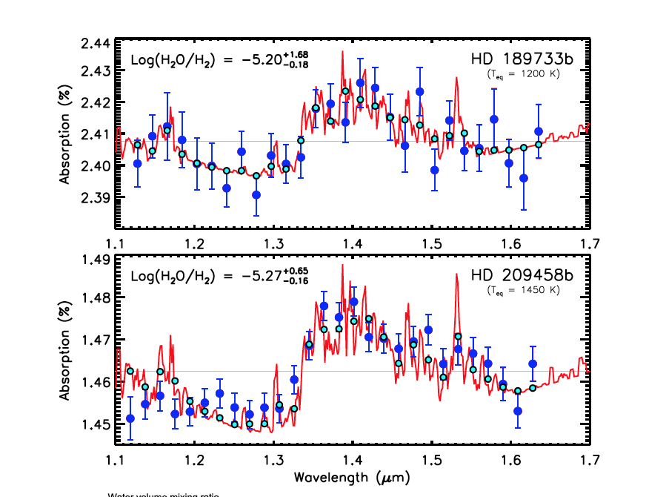
Exoplanet Research at Cambridge
Formation & dynamics
Detection and structure
Atmosphere
Habitability & Universal life
Fressin+ 2013

Slide 5
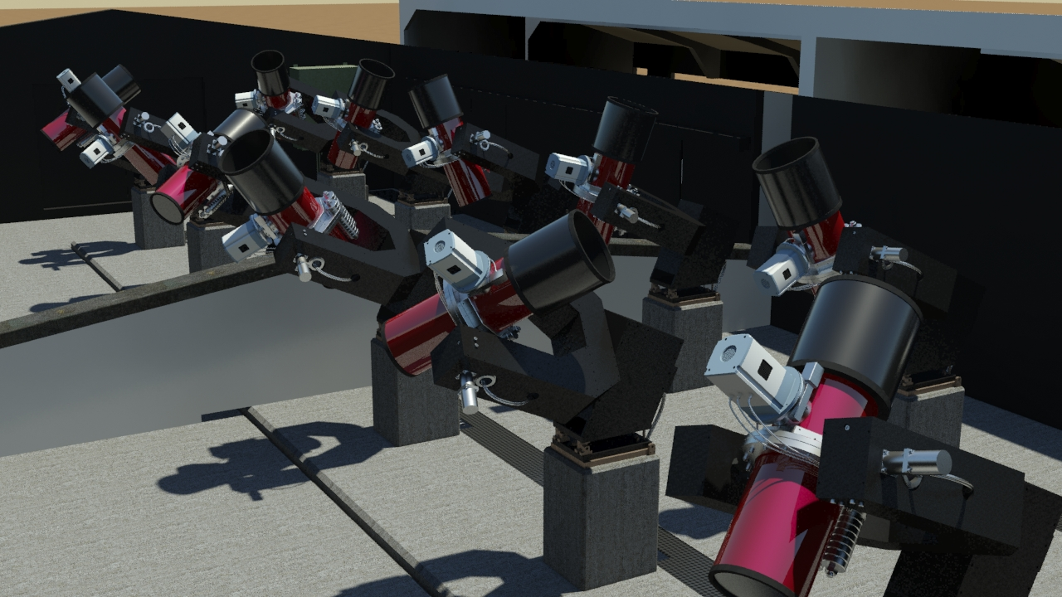
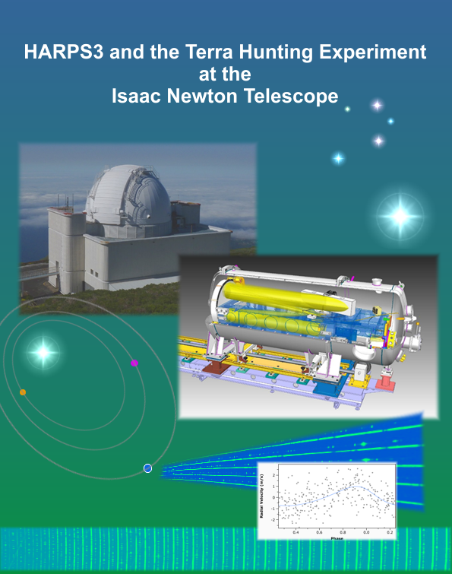
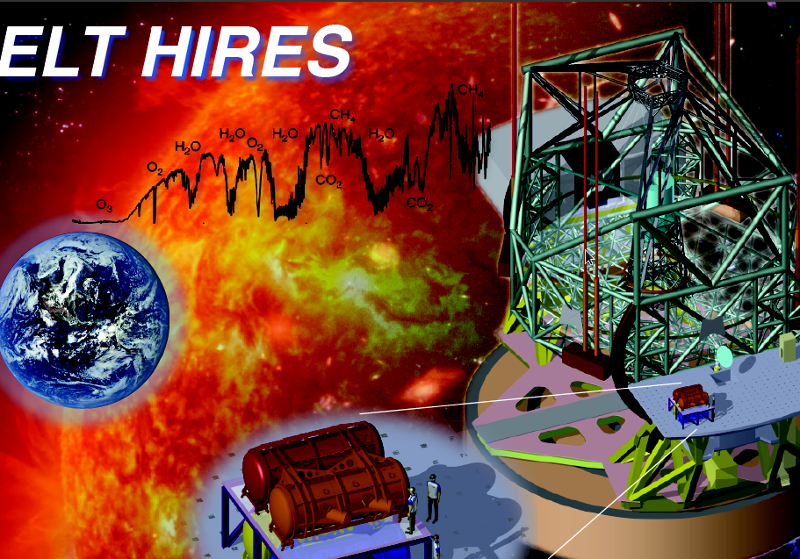
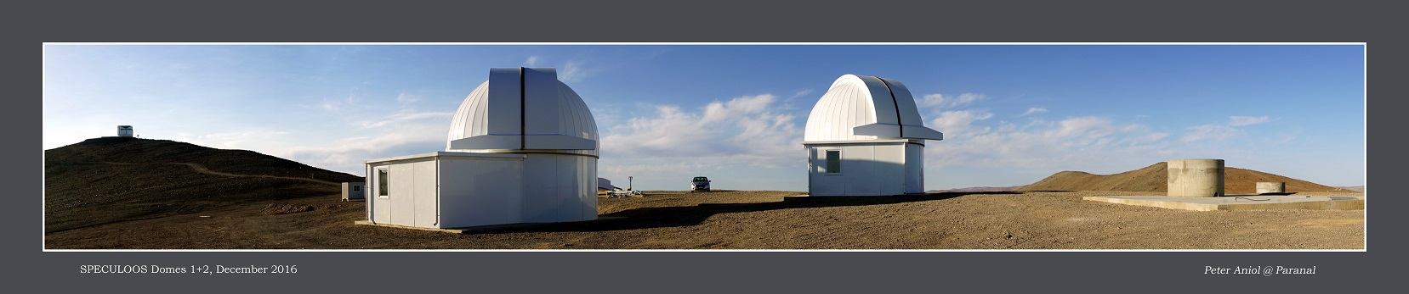
Instrumentation developments and related programs carried out at the Cavendish
Earth twin discovery
Identification of Transiting Super-Earth & Neptune
Measurement of molecules in atmosphere of small planets
Detection of Habitable planet on low mass stars
HARPS3 Terra Hunting
(2020)
NGTS – Paranal
(2016)
(2026)
SPECULOOS – Paranal
(2018)

Slide 6

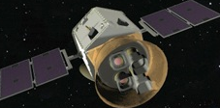
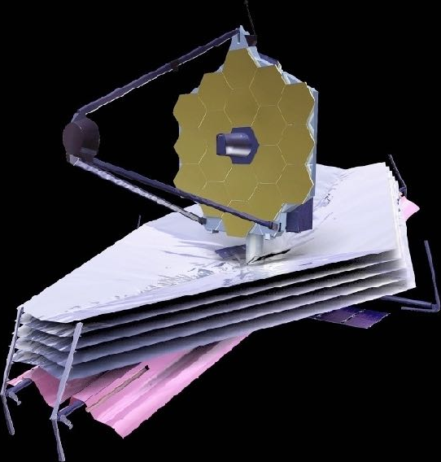
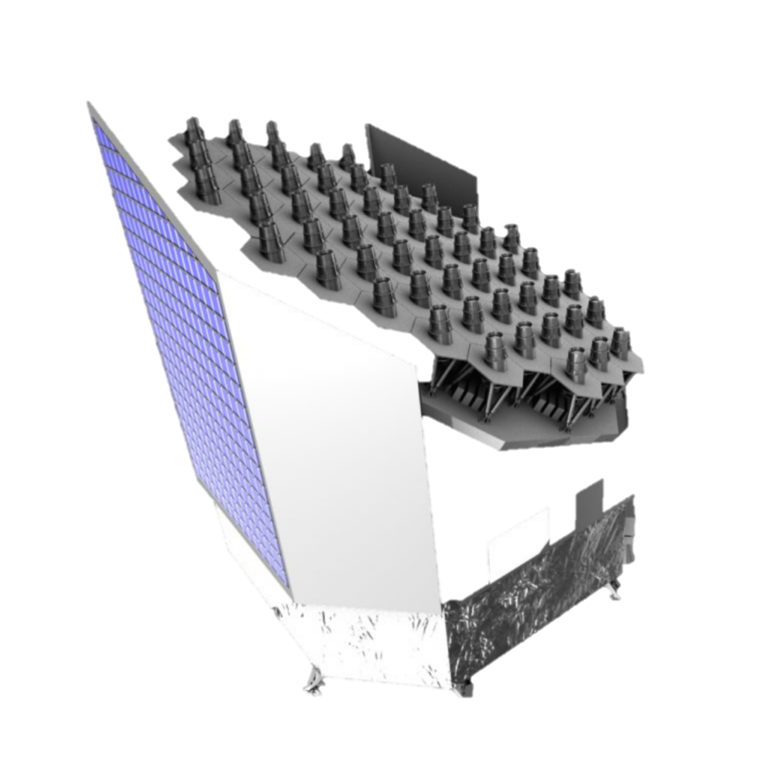
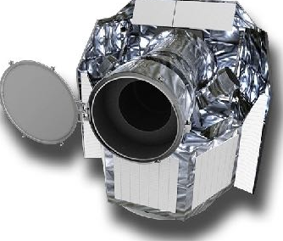
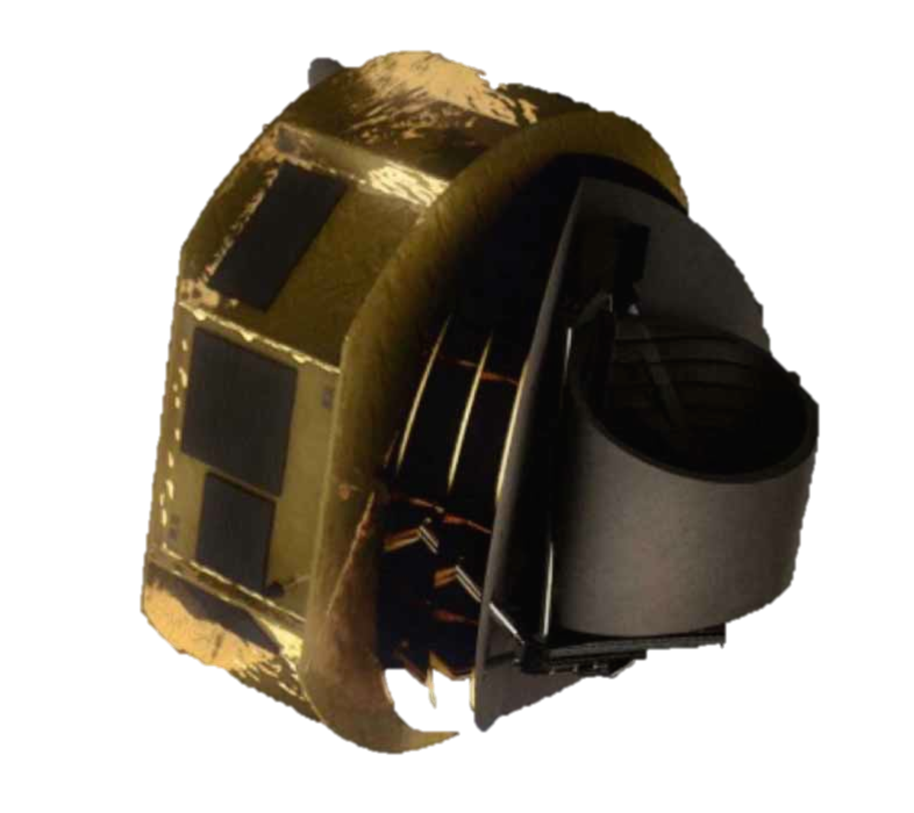
JWST (2020)
TESS (2018)
CHEOPS (2019)
PLATO (2024)
During the next 20 years
A Golden age of opportunities for exoplanet sciences !
ARIEL (2028)

Slide 7
Planetary research beyond the solar system
Cambridge Exoplanet Centre has established a stimulating working environment between IoA, DAMTP and AP supported by Kavli Institute and extended to Earth Science with a joint position
On-going multi-disciplinary initiative on origin, prevalence and nature of life in the Universe
In UK the field is booming (in the last 3 years) new faculty positions at Exeter (2), Warwick (3), Birmingham (1), Queen Mary London (1), Oxford (1)
Exoplanet research centres created at St- Andrews, Warwick, Oxford
Last Exoplanet UK yearly conference attracted close to 200 participants! (first one at Cambridge in 2014 had 100 attendees...)

Slide 8
Radio Cosmology and transient universe
Key scientific strategic drivers
What is the history of neutral hydrogen – baryonic building block of the universe
  Radio telescopes HERA and SKA to measure the neutral hydrogen
How do the first stars and galaxies form and evolve
  Radio telescopes HERA and SKA to measure the neutral hydrogen directly
  JWST and E-ELT to study the first galaxies and AGN directly
Use pulsars as natural clocks and position-shifts of stars to study long wavelength gravitational waves and the stochastic gravitational-wave background from inflation
  SKA to find appropriate pulsars and time them
  GAIA for position measurements and to cross-correlate with SKA
Do laws of physics change with cosmic epoch – traced by looking for variations in fundamental constants
  High resolution spectroscopy of key spectral lines with SKA and E-ELT

Slide 9
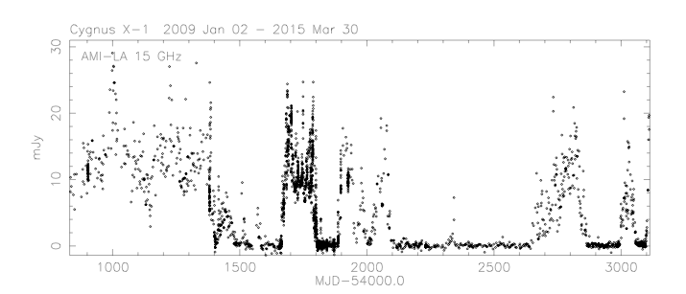
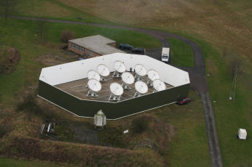
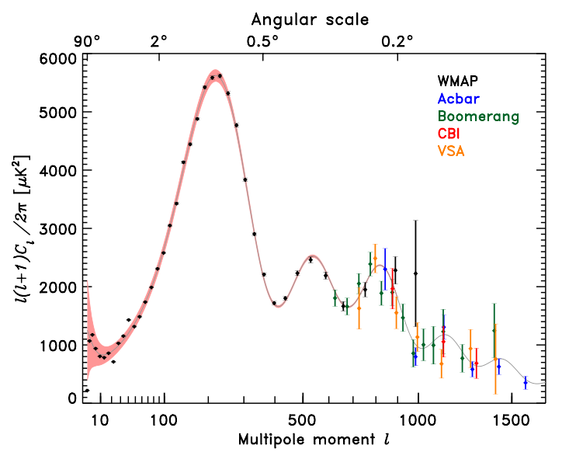
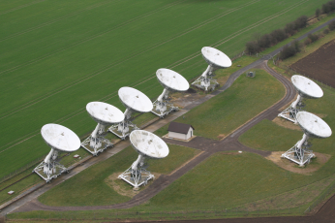
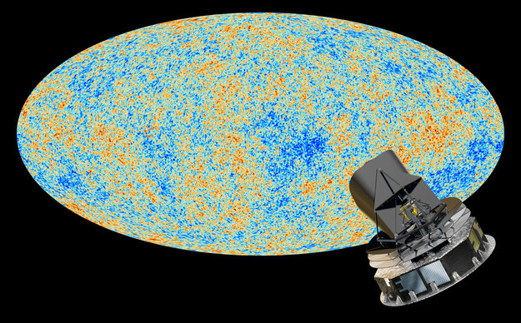
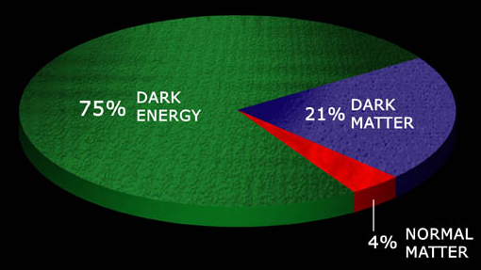
Cosmic Microwave Background
Measurements of CMB power-spectrum have established
era of “precision cosmology”
Powerful combination of smaller-scale experiments and leading role in major international projects
Planck Sky

Slide 10
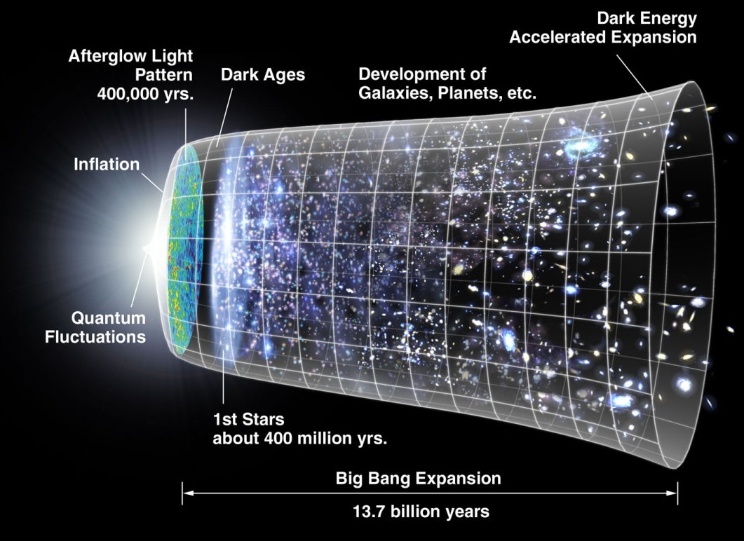
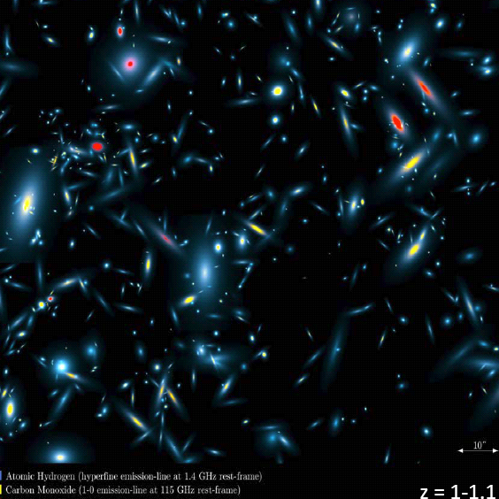
Hydrogen Evolution

Slide 11
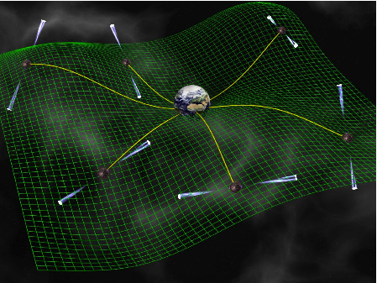
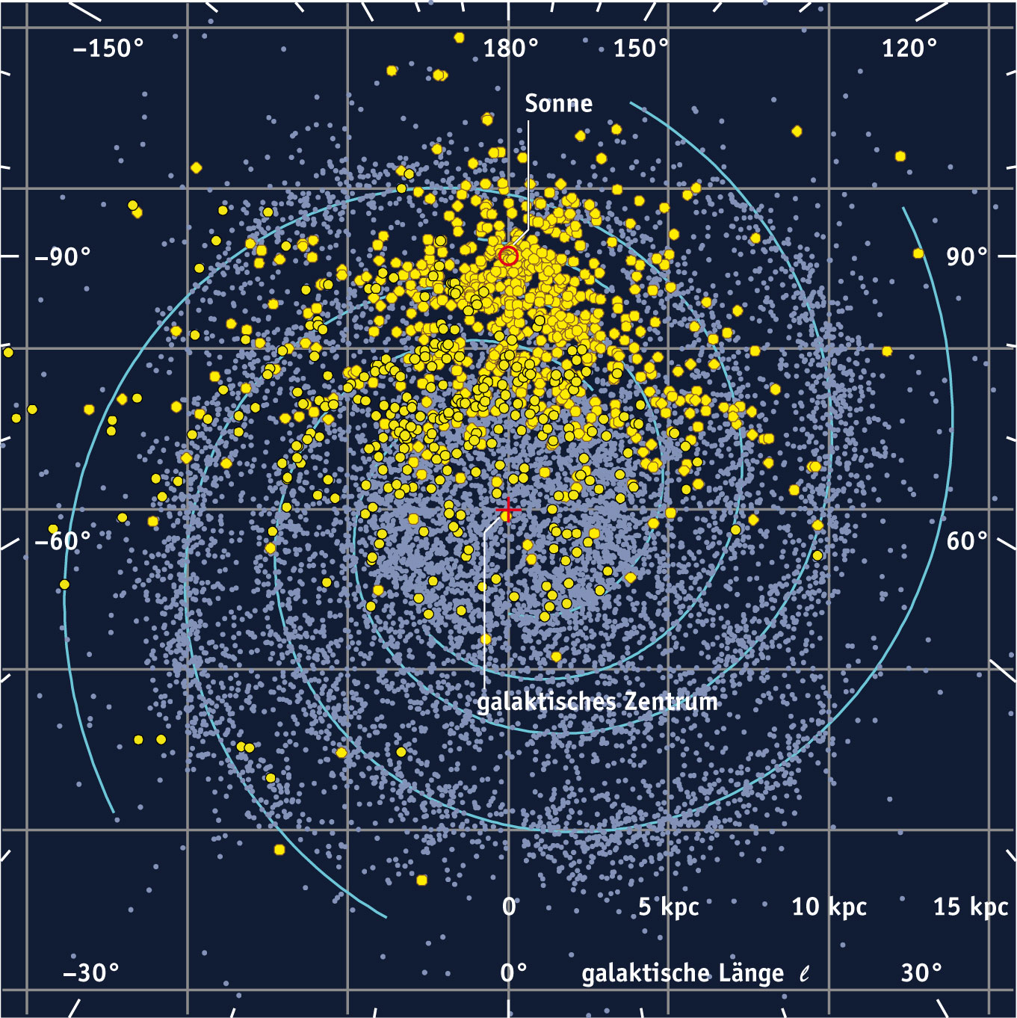
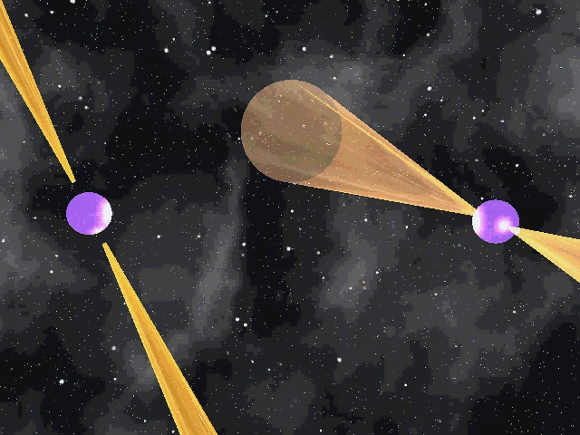
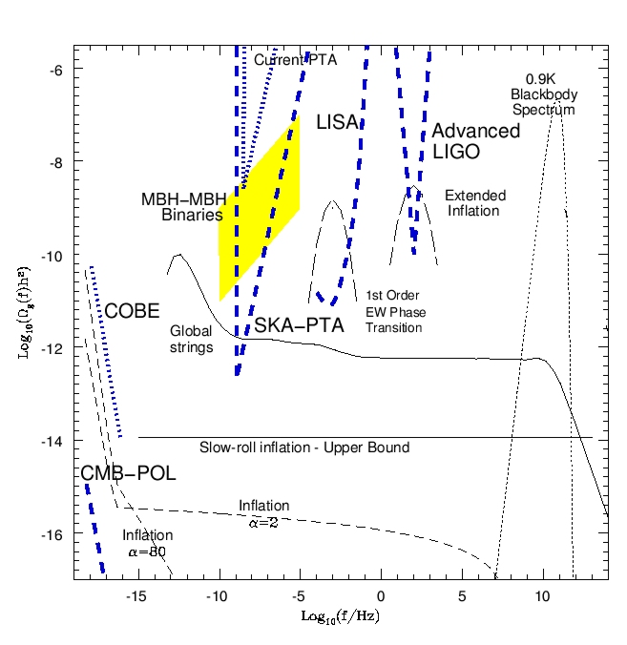
Pulsar Surveys: Testing gravity
The SKA will detect around 20,000 pulsars
Relativistic binaries give unprecedented strong-field test of gravity
Timing net of millisecond pulsars to detect gravitational waves via timing residuals
Notes:
Epoch of re-ionisation is a crucial stage in cosmological evolution as the first compact objects form and turn on

Slide 12
The Square Kilometre Array (SKA)
Next Generation radio telescope – compared to now ...
  ~100 times sensitivity
  ~ 10⁶ times faster imaging the sky
  More than 5 square km of collecting area on size 3000km
  Will be built in phases with first phase completed 2024
    Roughly 10% with sizes up to 180km
Will address some of the key problems of astrophysics, cosmology and physics
Builds on techniques developed in Cambridge
  It is an interferometer
  Uses Earth rotation aperture synthesis
We lead the design of the low-frequency element and of the very demanding data processing system (algorithms, software and hardware)

Slide 13
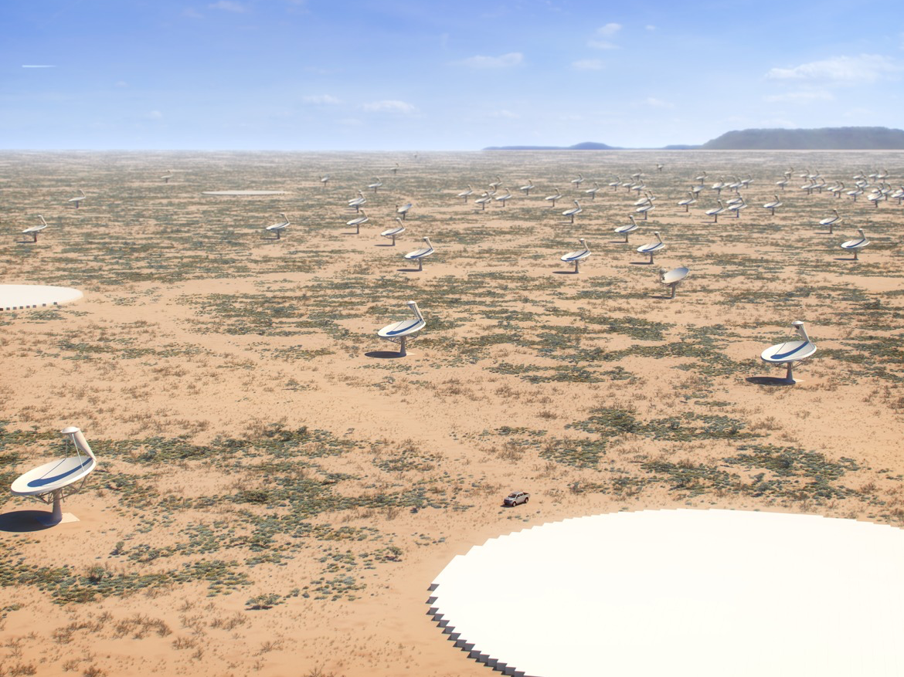
Mid-frequency in Karoo, South Africa

Slide 14
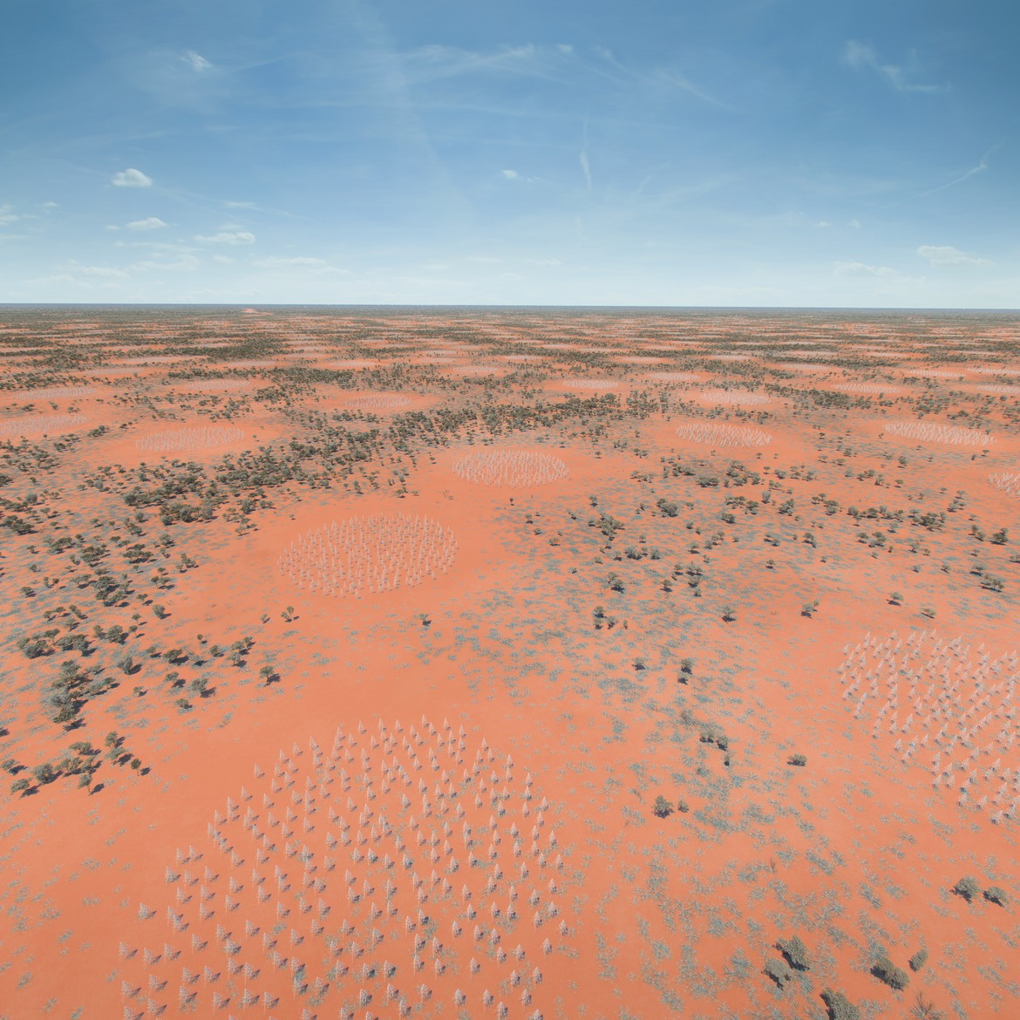
Low-frequency array in Western Australia

Slide 15
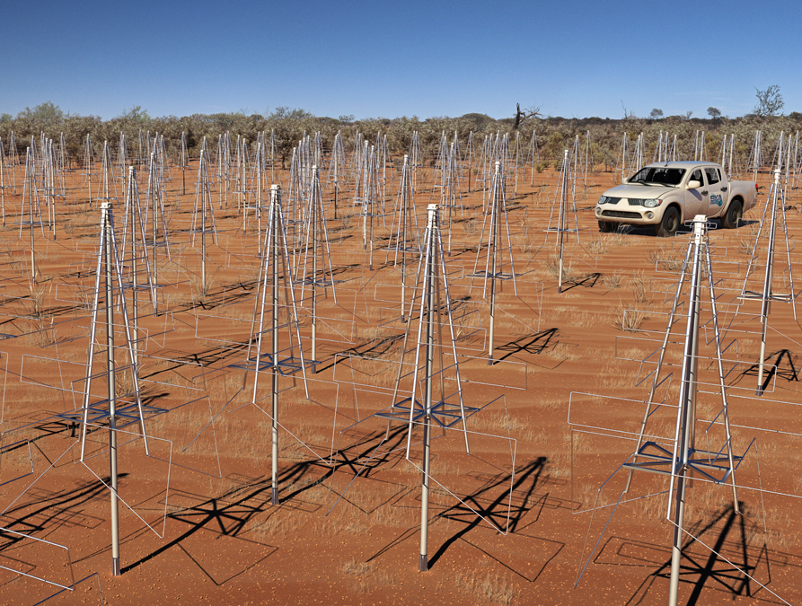
Cambridge designed low-frequency antennas 40-350 MHz

Slide 16
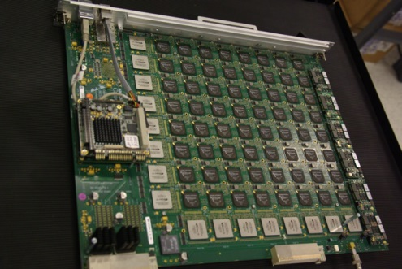
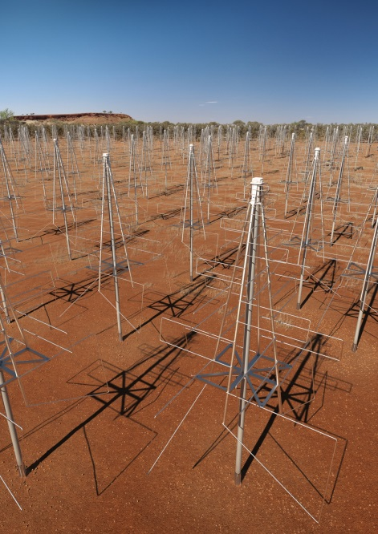
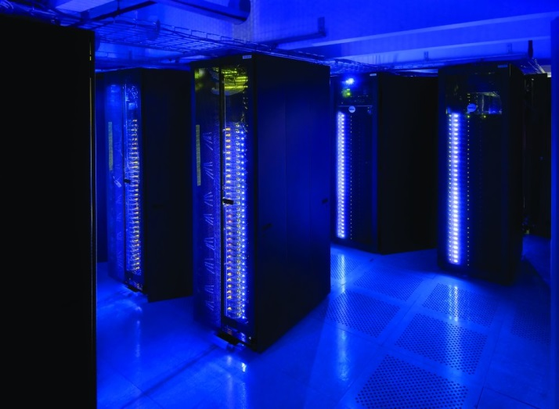
A Leading Big Data Challenge for 2020 decade
Digital Signal Processing (DSP)
To Process in HPC
2024: 50 PBytes/day
2034: 10,000 PBytes/day
Over 10’s to 1000’s kms
Antennas
Transfer antennas to DSP
2020: 5,000 PBytes/day
2030: 100,000 PBytes/day
Over 10’s to 1000’s kms
HPC Processing
2024: 300 PFlop
2034: 30 EFlop
High Performance Computing Facility (HPC)

Slide 17
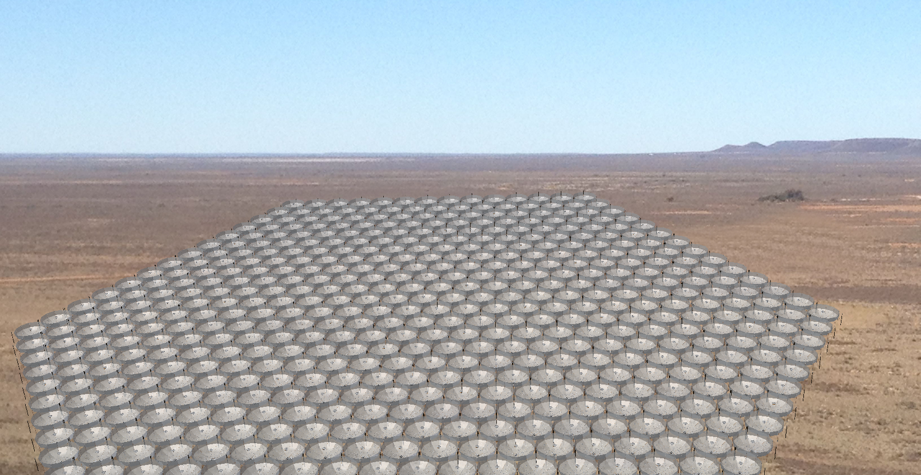
HERA – Studying the History of Hydrogen
and the First Galaxies

Slide 18
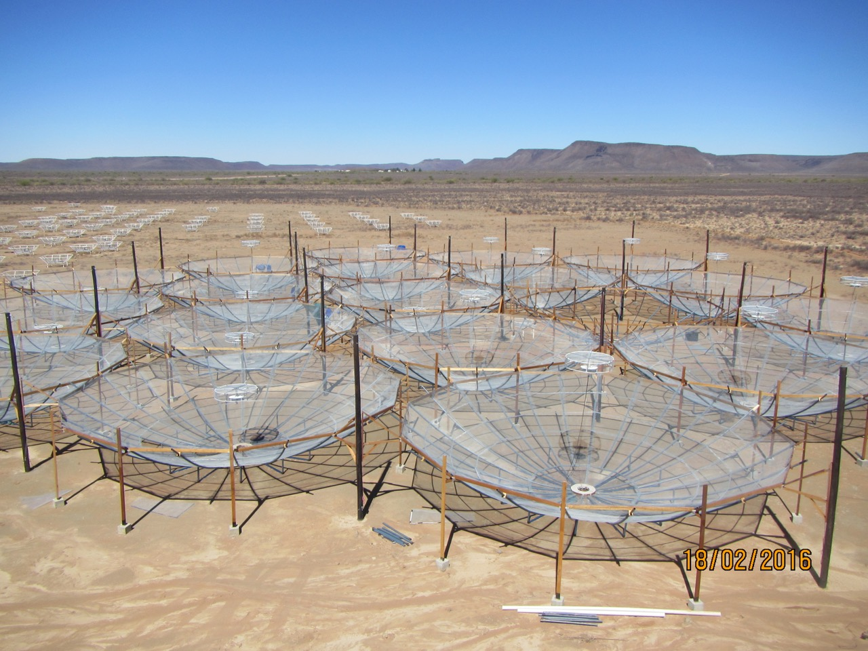
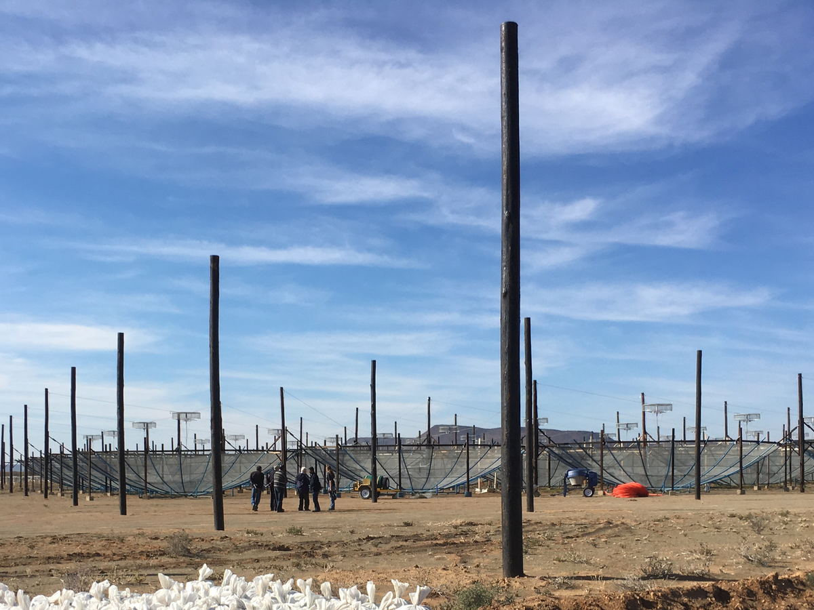
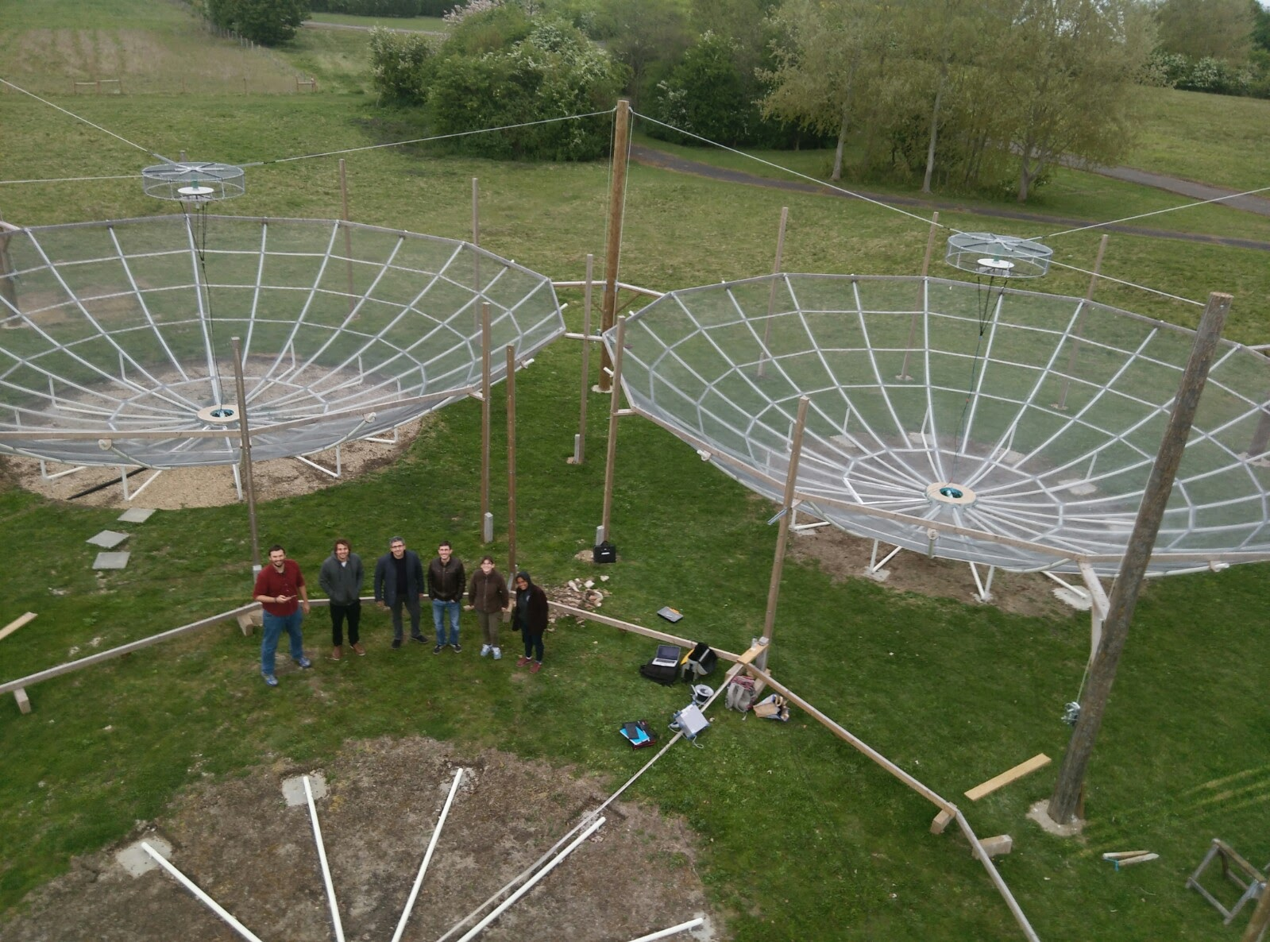
HERA Overview
14m (42ft) transit elements
Hexagonal grid 300m across
350 elements in total
  320 in compact array, 30 outriggers
  Staged build (with science)
    HERA-37, HERA-127, HERA-240
  Baselines from:
    14.6 – 292m Core and
    14.6 – 876m including outriggers
  Major leading contribution
    Leading sspects of data analysis
    Design of the feeds and electronics
HERA 37 Commissioning 2017

Slide 19
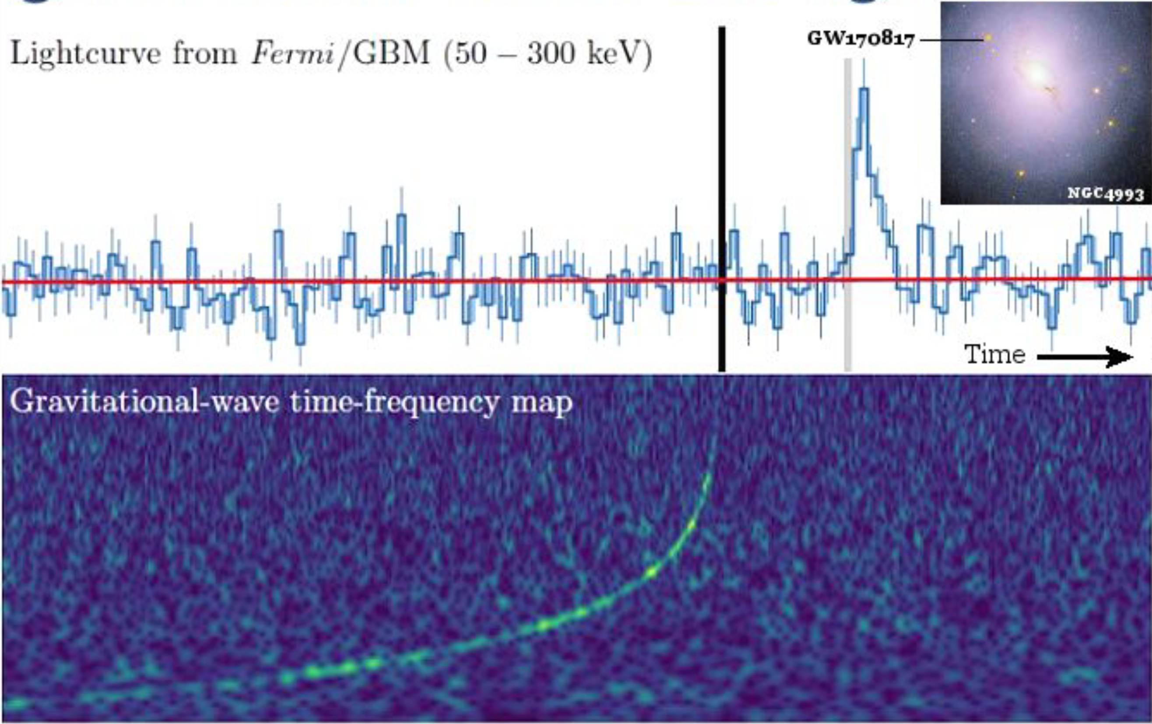
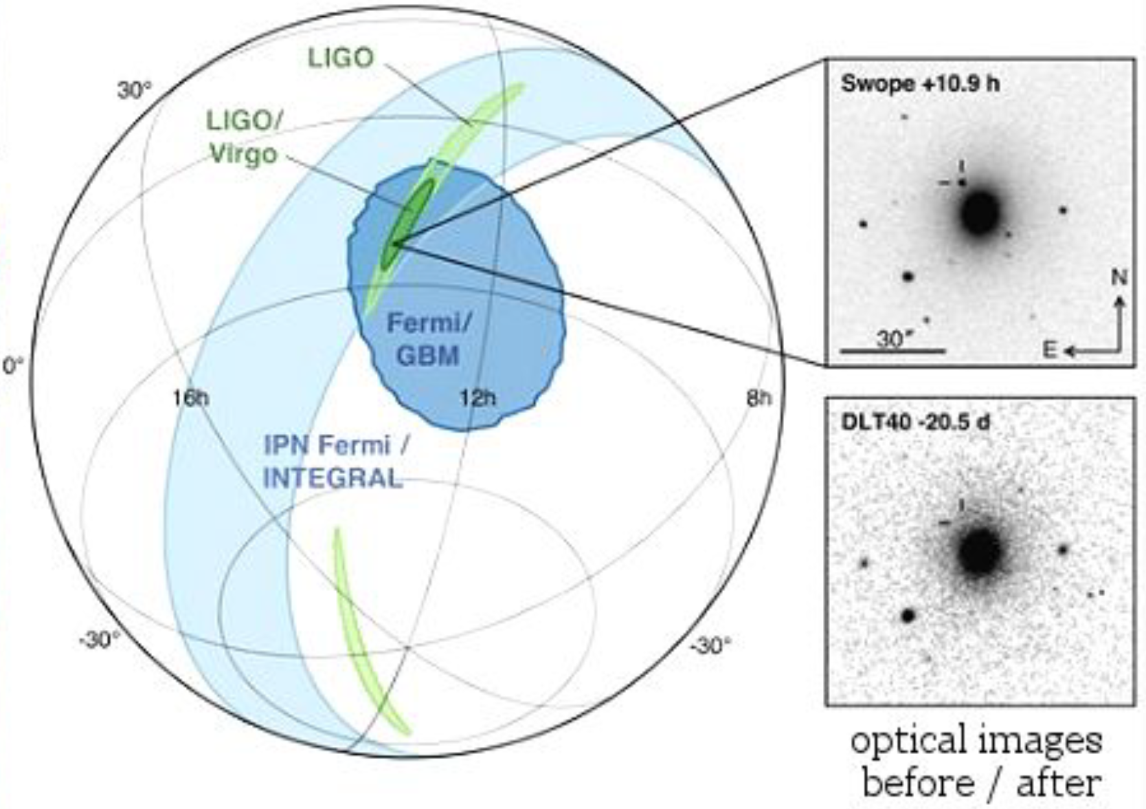
Gravitational Waves
A new window on the universe and fundamental physics
Tests ‘strong gravity’ regime of physics in a way not possible before (e.g. detailed features of the fields around black holes and neutron stars, constraints on alternative gravity theories and limits on graviton mass)
After discovery of neutron star-neutron star binary coalescence, links directly to electromagnetic observations, and has given us a new window into extreme astrophysical events

Slide 20
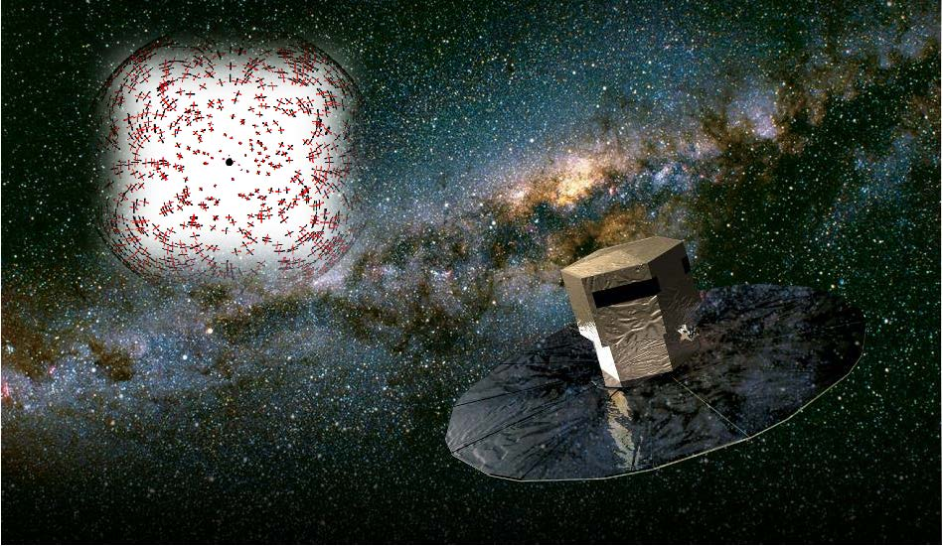
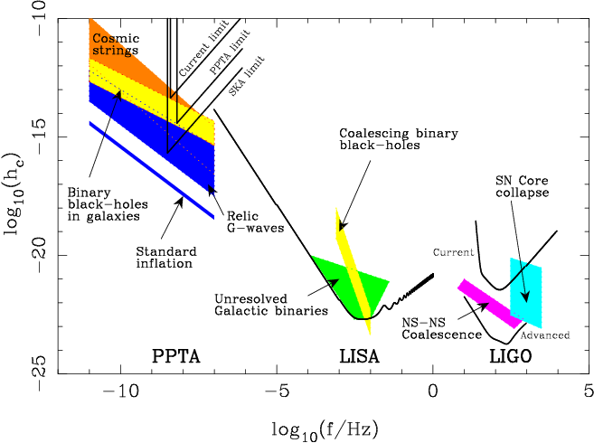
Cambridge skills in GW science
DAMTP world leaders in gravitational physics theory
Cavendish strengths in statistical work plus gravitational theory
IOA strongly involved in electromagnetic followup
Specific aspects currently being worked on include neutron star equation of state (highly condensed matter!) plus tests of alternative gravity theories (DAMTP)
Use of data from Gaia satellite to detect coherent patterns of star movements due to gravitational waves from the merger of black holes at the centre of galaxies (Cavendish/IoA/DAMTP)
New Bayesian statistical methods for gravitational wave data analysis (Cavendish)
Use of Pulsar Timing Arrays for detection of very low frequency gravitational waves (Cavendish)
However, Cambridge has no faculty involved in gravitational waves who are also full LIGO authors, or on science teams of any future experiments

Slide 21

Black holes, galaxy formation
and fundamental physics

Slide 22
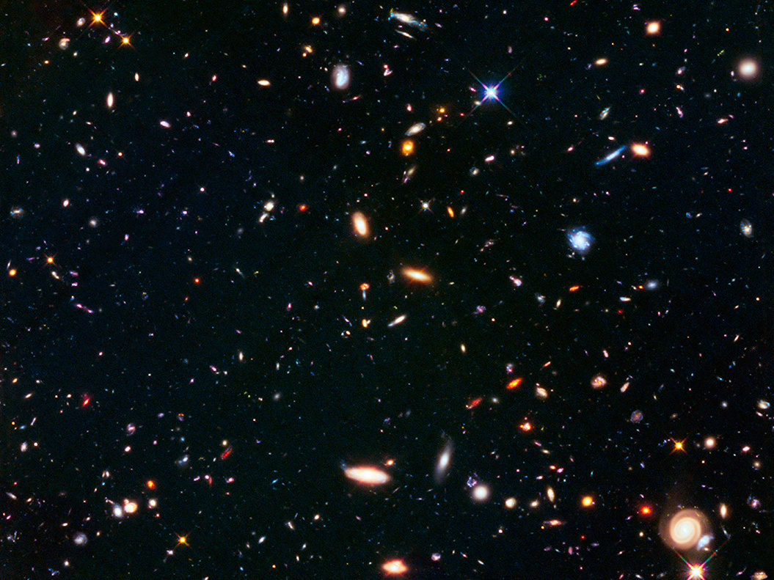
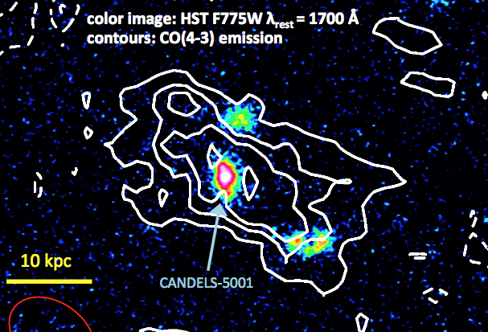
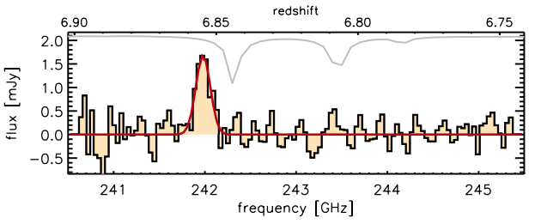
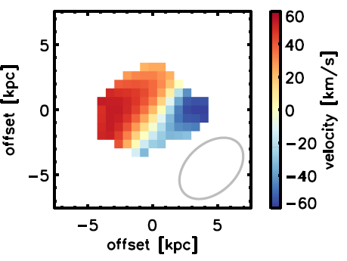
Detection of the first stars and first galaxies
Properties of the very first galaxies, which re-ionized the Universe
Formation of the first heavy elements, first solid particles (dust grains)
and first molecules in the Universe
Galaxy assembly and evolution across the cosmic epochs
(galaxy merging vs smooth accretion)
Accretion of molecular gas onto
a massive in the early Universe
Discovery of regular disc rotation in a proto-galaxy
at z~7 (age of Universe 6% of current age)
through detection of ionized carbon
Carbon Monoxide
C⁺ 158μm
(Nature press release)

Slide 23

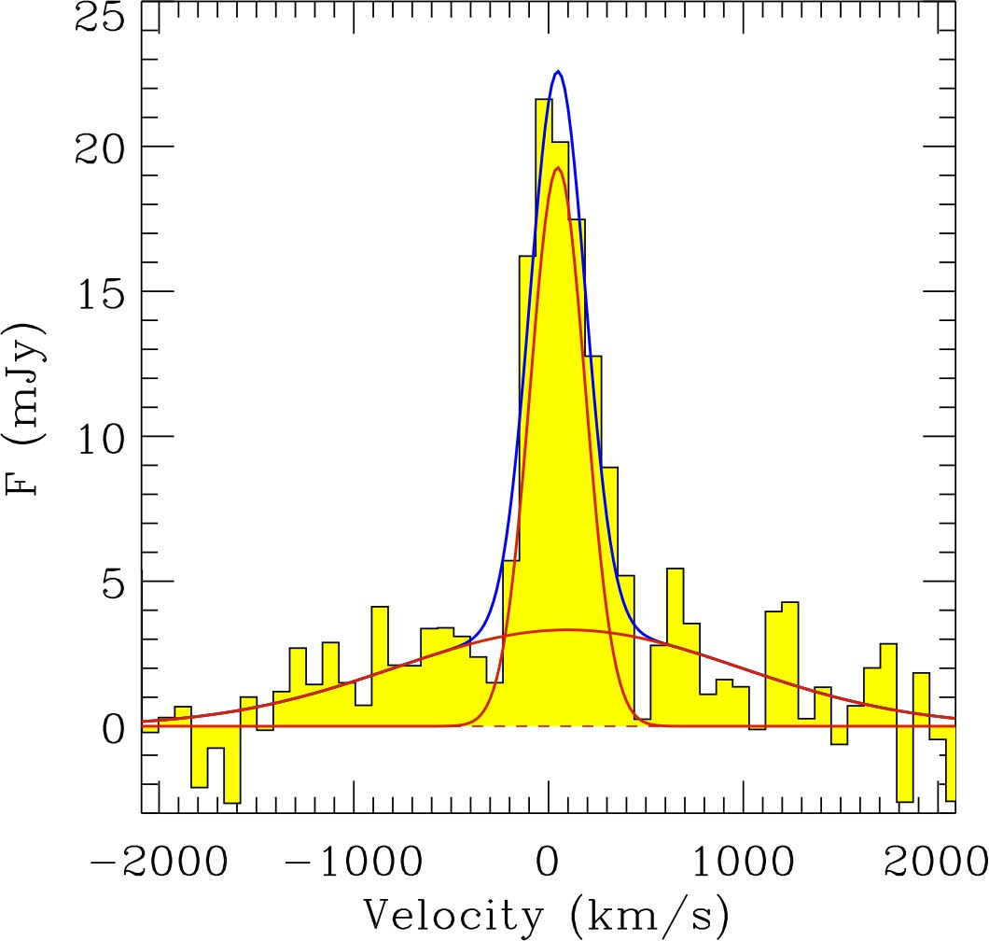
Supermassive Black Holes and Quasars
Origin of Black Hole seeds in the early Universe
Contribution of accreting Black Holes (quasars) to the
re-ionization of the Universe
Black Hole feedback on galaxy evolution:
  - Galaxy transformation: star forming ➔ quiescent
  - Quasar-driven winds as birth site of new stars
  (background Nature press release)
C⁺ 158μm
at z=6.4
C⁺ map
at z=6.4
Giant high velocity
outflow driven by
one of the most
powerful quasars
in the early Universe

Slide 24
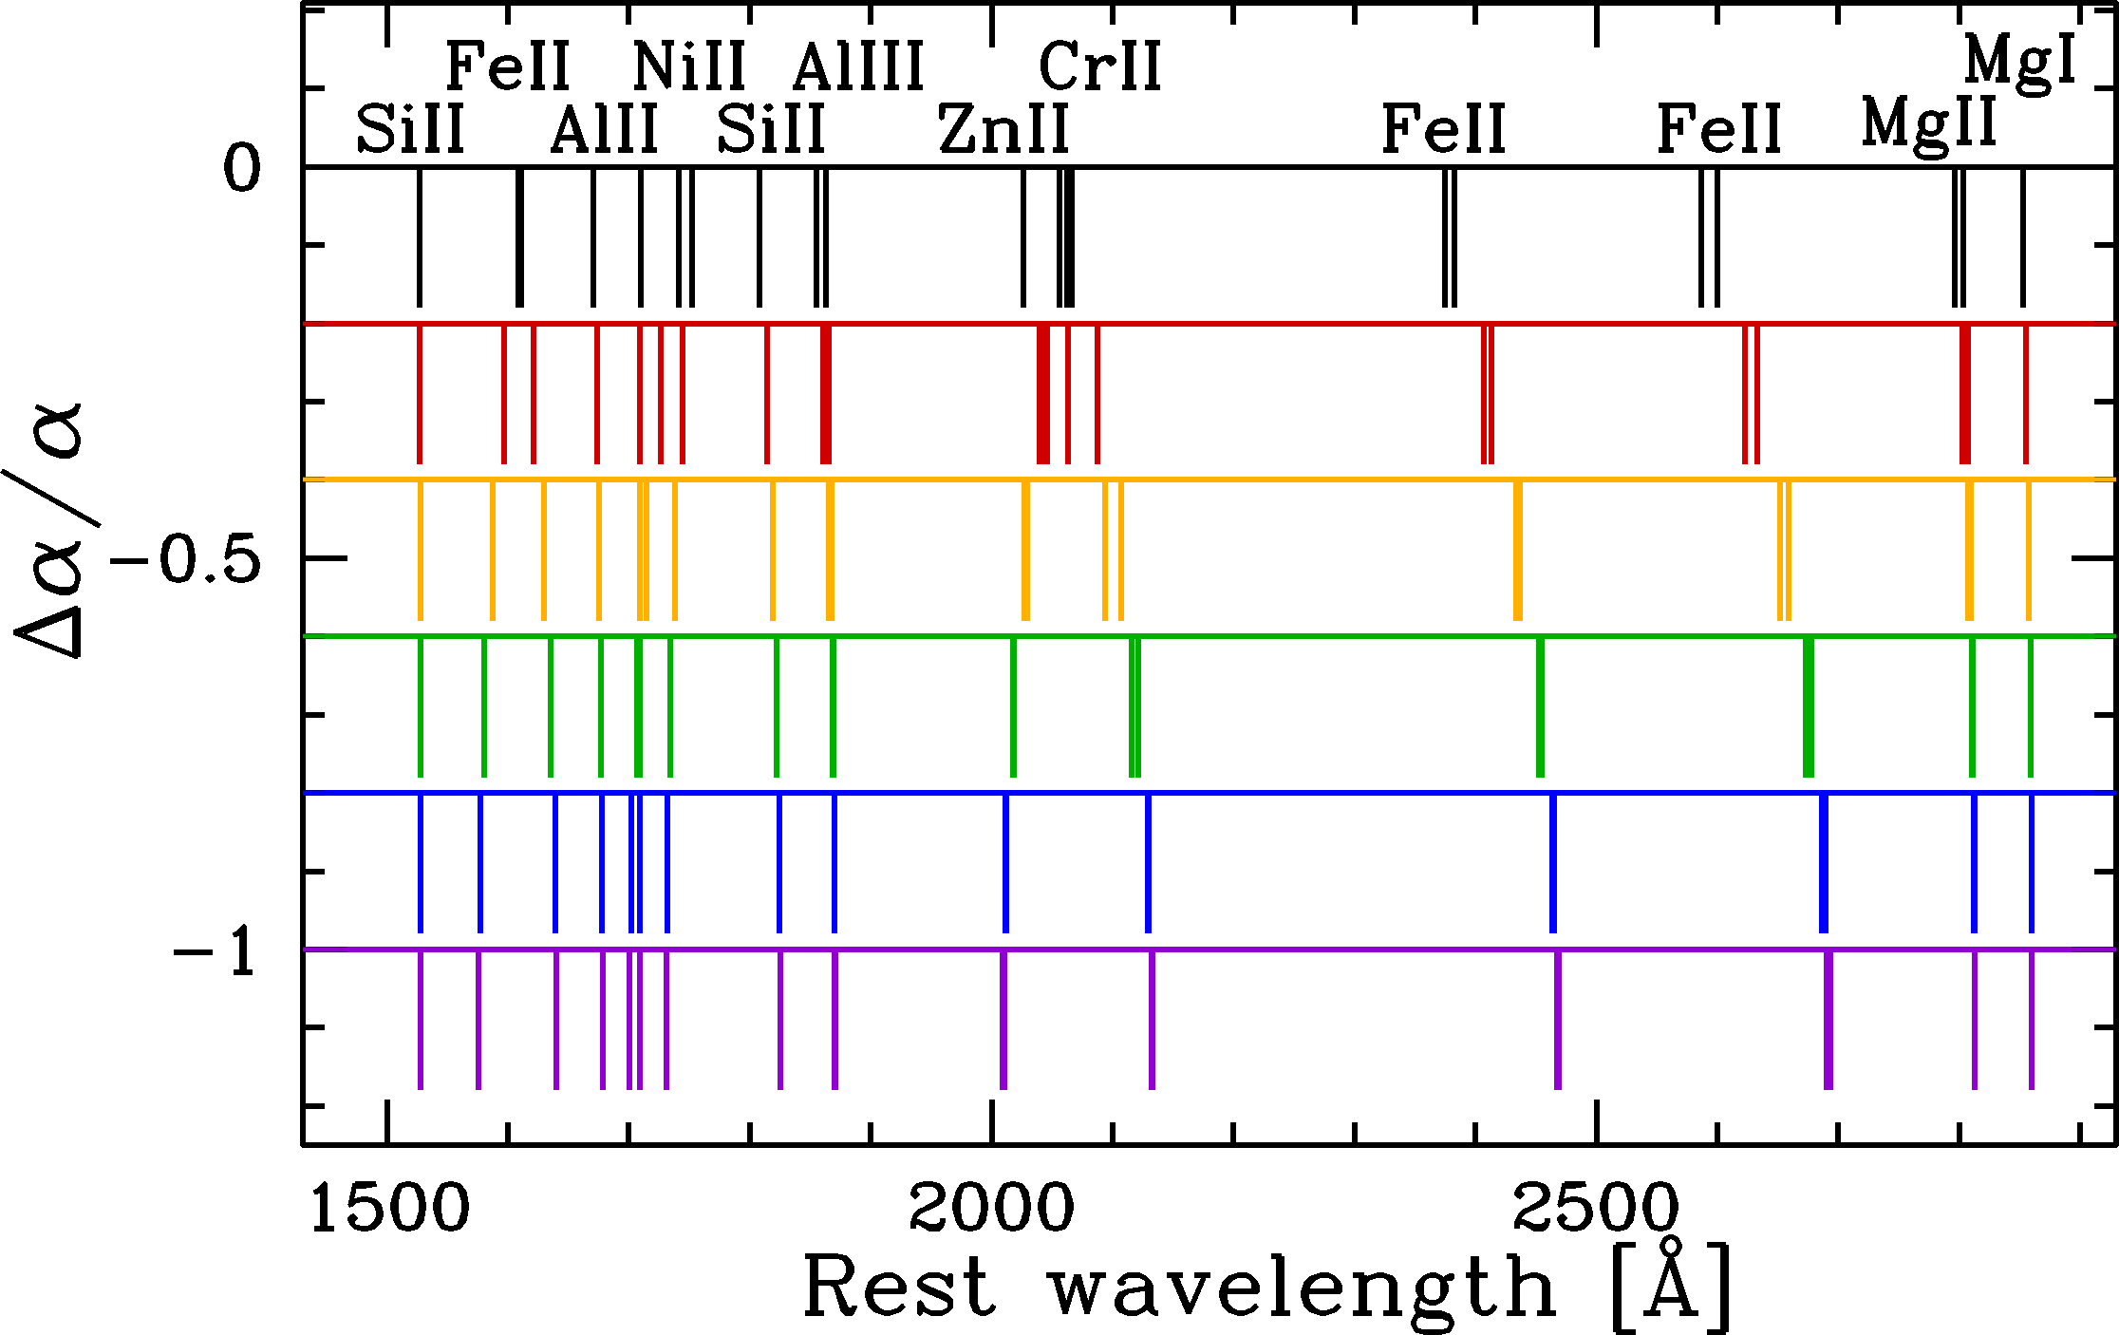
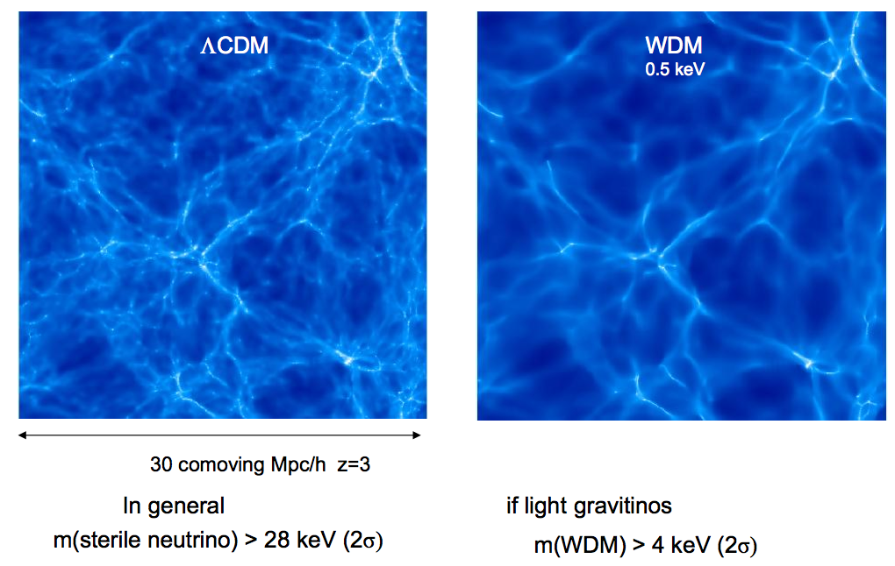
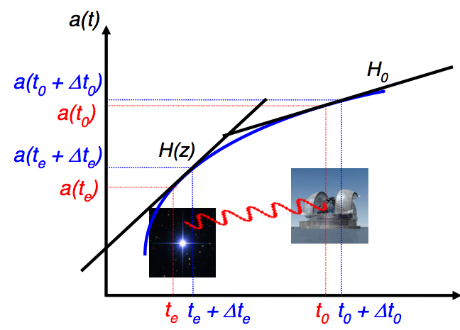
Fundamental Physics
- Cosmic variation of fundamental constants
(m_{p}/m_{e} , α = e⁻²/4π)
- Mass of Dark Matter particles
- Nature of Dark Energy
Direct, real-time measurement
of the acceleration of the Universe

Slide 25
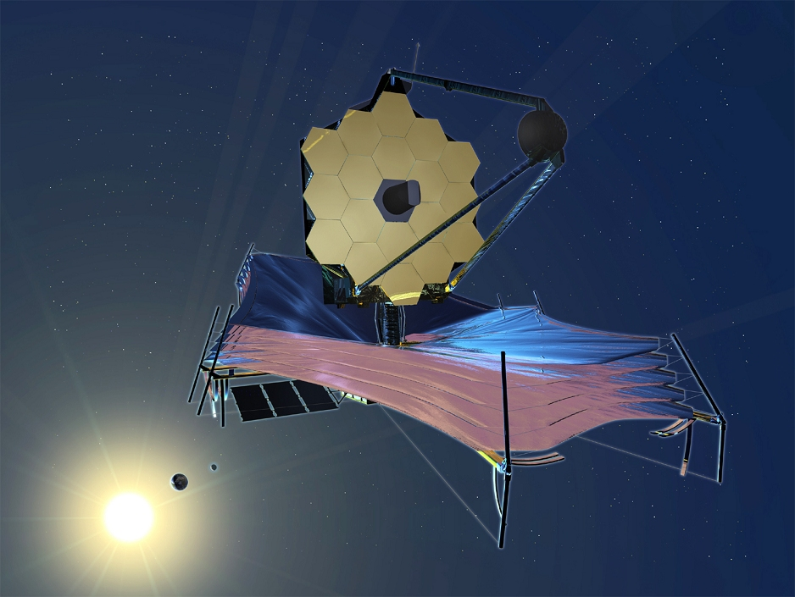
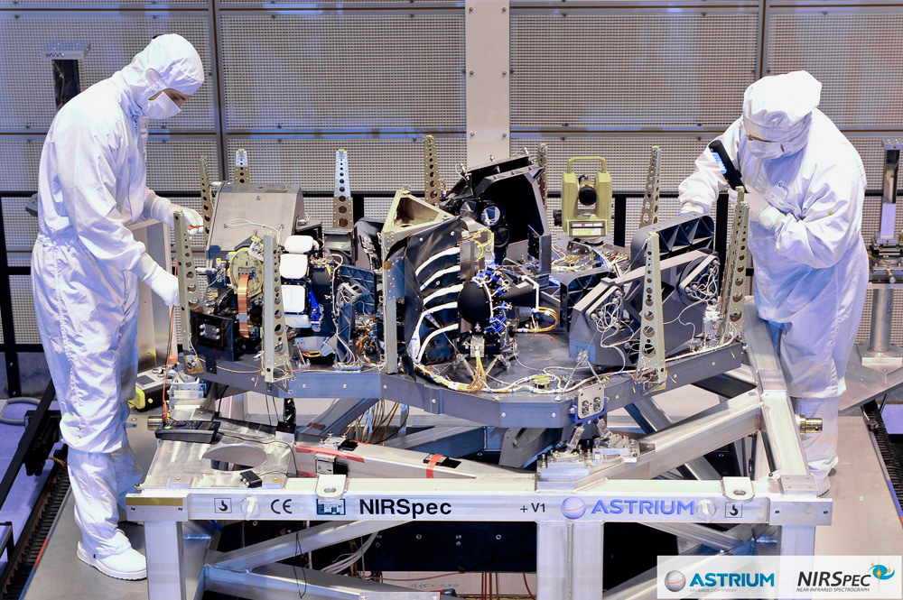


The James Webb Space Telescope
The largest telescope in space
NIRSpec
Launch in 2020
Cavendish part of the
main spectrometer
(NIRSpec) team
access to 900 hours
of guaranteed observations
(equivalent to an investment of $200M)
dedicated to the study of primeval galaxies

Slide 26





Launch in 2020
Cavendish part of the
main spectrometer
(NIRSpec) team
access to 900 hours
of guaranteed observations
equivalent to an investment of $200M
dedicated to the study of primeval
galaxies
Huge leap in
sensitivity!
Hubble
deep image
James Webb
shallow image

Slide 27


MOONS: the next generation
near-IR multi-object spectrograph
for the Very Large Telescope
- Cavendish: design and
assembly of cameras
+ science lead
(Project Scientist)
- 300 Nights of Guaranteed
Observations
- First light 2021
Mapping and characterizing
millions of galaxies
in the early Universe

Slide 28

The Extremely Large Telescope (ELT)
In 2024 will be the largest optical / IR telescope
in the world (39m diameter)
Cavendish leading the UK participation
in HIRES, the high resolution
spectrograph+ science lead

Slide 29
Route: Optical instrumentation
the scientific aim is focussed on high-resolution spectroscopy for extra-solar planetary science and the signatures of the first stellar systems in the universe:
  Play a key role in MOONS: this is a common-user multi-object spectrograph for the VLT and will establish us as producing common-user instrumentation in addition to innovative optics
  Deliver HARPS-3 for the INT – demonstrate the ability to lead and deliver a full science instrument
  Establish a lead role in the E-ELT instrument HiRES with Cambridge leadership from Maiolino, Haenhelt and Queloz.
  Continue at the leading edge of instrumentation for optical interferometry
The strategy has been in place for over 3 years and we have been fully successful in establishing the Group’s position in MOONS and the early work for HiRES. Completing the new laboratory area is critical to this strategy

Slide 30
Route: Radio Astronomy Technology
Our expertise in this area are two-fold:
  Overall system design of radio telescopes
  World-leading antenna and front-end design: this activity in particular, is strengthened immensely by access to Lords Bridge and this leads the requirement to update the Lords Bridge facilities.
This has been critical in establishing a leading role in the SKA and HERA

Slide 31
Route: Centre for Exascale astronomy
Exploit leadership in Bayesian statistics, expertise in data processing, and management of BigData to apply to various science areas. This is a Cambridge-wide strength, but one in which we in the Cavendish lead:
  Leading the SKA Science Data Processor design: the SKA is one of the main “Big Data” challenges for science in the coming decade and Cambridge leads the cutting-edge design work.
  Statistics and machine learning: a major strength in Cambridge and the Cavendish especially in application of Bayesian approaches.
  Programming models and computer architecture: strength across Cambridge – new C²D³ IRC
  Proven ability to deliver: recent examples in Cambridge include Planck and GAIA.
Strategy is to create a Cambridge-wide activity which delivers research in this area directly and then deliver:
  SKA Regional centre (£1m/yr long term funding)
  Centre for JWST data analysis
  + …

Slide 32
Strategic Priorities – across Cambridge
Coordination across Cambridge (AP, IoA, DAMTP) now very good with Kavli at the centre. This must continue at all levels and be very joined up
Faculty positions in these areas:
  Extra-solar planetary experimental
  Radio cosmology experimental
  Galaxy evolution specialist in optical & IR analysis
  Gravitational wave to link to experiments
  Exascale astronomy and bayesian analysis
Strategy seed funding availability:
  Ability to engage early can lead to significant advantage especially with US partners
Support structure for technical staff and a good long-term career path
  Cross-school positions with SoT may be very attractive

Slide 33
Strategic Priorities – returns and funding
Science is we think very much leading internationally and of very significant intellectual impact beyond traditional astronomy interests
All areas are strongly supported by STFC and other sources with significant and proven grant income potential:
  Extra-solar planetary science attracting significant non-RC income
  Radio cosmology / SKA currently about £3m/yr real possibility of maintaining this until 2024 and beyond
  JWST science case already attracted £5m
  Exascale astronomy and Bayesian analysis – strong interdisciplinary income potential (e.g. £1m Shell, £25m to CBD SRI from a commercial partner, significant income for University computing infrastructure, £10m over 18 months, …)

